Slide 1


Team Titans
Right Direction
Titans
Srihar Kotela
Thomas Falk
Rama Reddy Kovvuri
Chandra Sekhar K
Mukul Purohit
Venkata Gurram
Swapnil Belapurkar
Madhavi C
Digital Technology Towards Better Farming

Slide 2
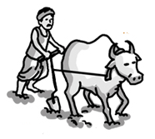
Indian Farmer Challenges
Access to Agriculture Info
Lack Adaptability to Risks and Vulnerability climate change
Lack of knowledge on Technologies, Markets and system dynamics
Poor monetization of farm produce
Awareness on Govt. Schemes , Value adding Mechanization and Insurance Options
Low Productivity
Risk Management
Unsustainable use of Natural Resources

Slide 3

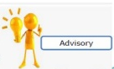







Krushak Nirdeshak
Spatially explicit Multi Player Simulation game based on inter linked Multiple System Models and Real & Generated data.
Multi Player Social Collaboration tool
Crop Advisory Services
Pest and Disease Management
Crop Selection
Surprise Elements
(Adverse Weather, Climate Control,
Pest and Disease)
Farm Mechanization
Market Info
Cooperation of water management

Slide 4

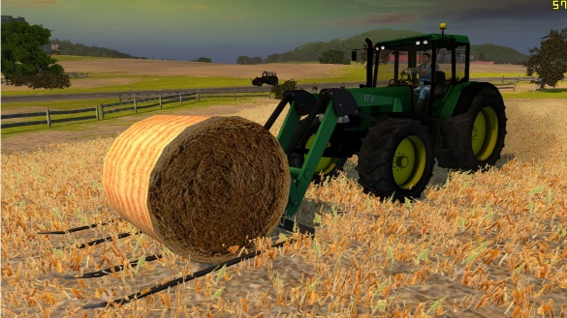

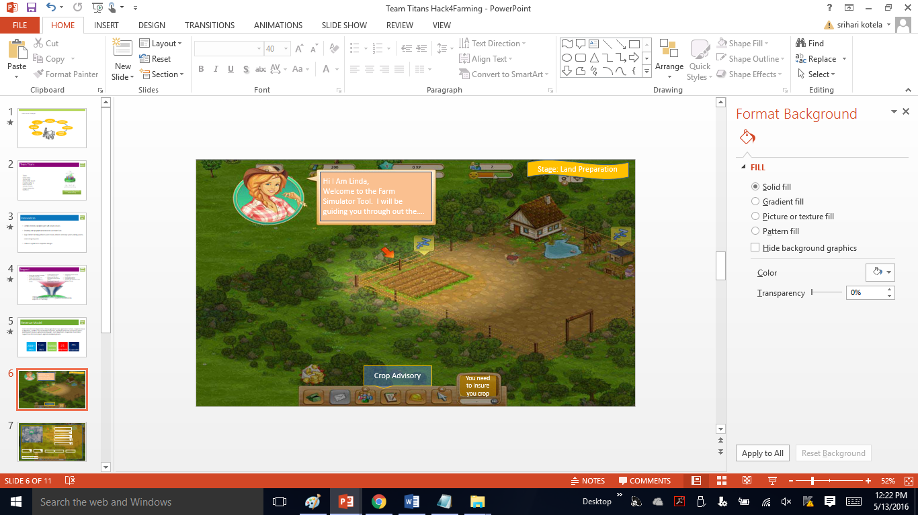




Topographical data
Team
Titans
Weather data
Simulation Game
Soil and Crop pattern data
Azure Service
Seed, Fertilizer, Pesticide data
Farm Equipment data
Marketplace data

Slide 5
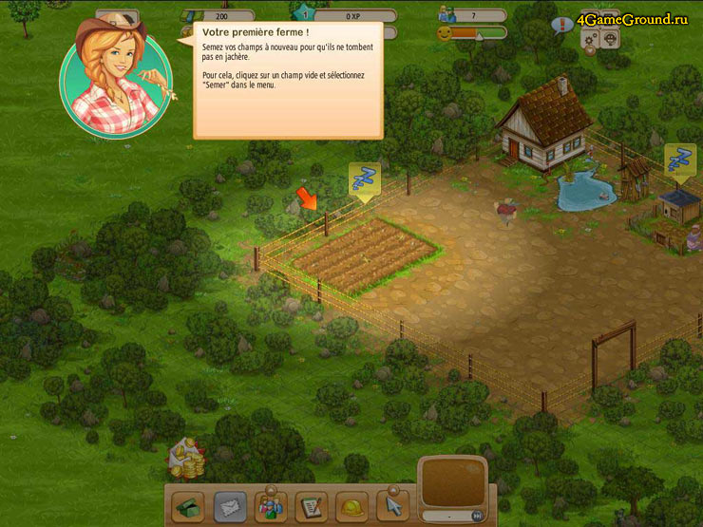
Stage: Land Preparation
Hi I Am Linda,
Welcome to the Farm Simulator Tool. I will be guiding you through out the….
Crop Advisory
You need to insure you crop

Slide 6
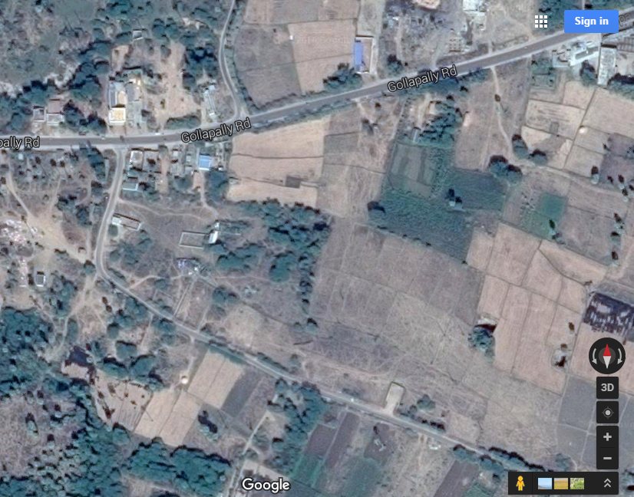
Name:
Select Country
Select State
Select Mandal
Select Village
GIS Plotting
Season
Type of Crop
Soil Type
Source of Irrigation
Ground Water Levels
Whether Parameters
Temp | RH% | Rainfall
Min: 22 Max: 37 | 60-80 | 1500mm

Slide 7


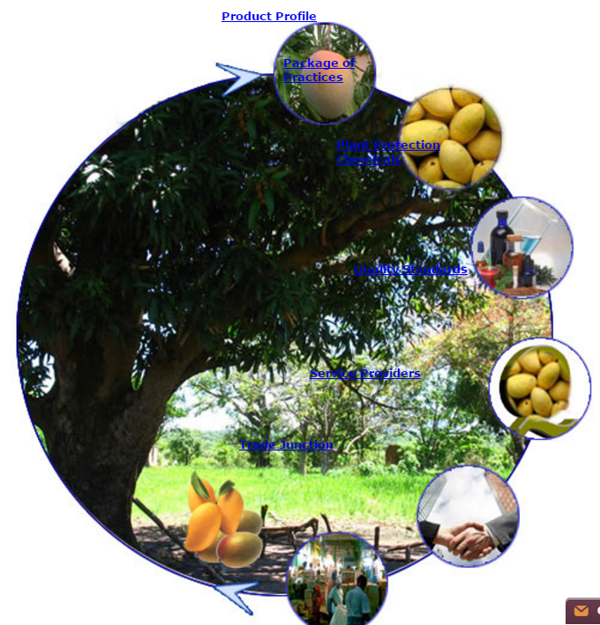

Suggested Crops
Value added products available for the selected Product
Pulp
Mango Jelly
Pickles
Juice
Crop Technical Info
Crop 1
Mango
Crop 2
Pomegranate
Crop 3
Lime
Crop Varities
Banganpally
Dasseri
Alphanso
Totapuri

Slide 8
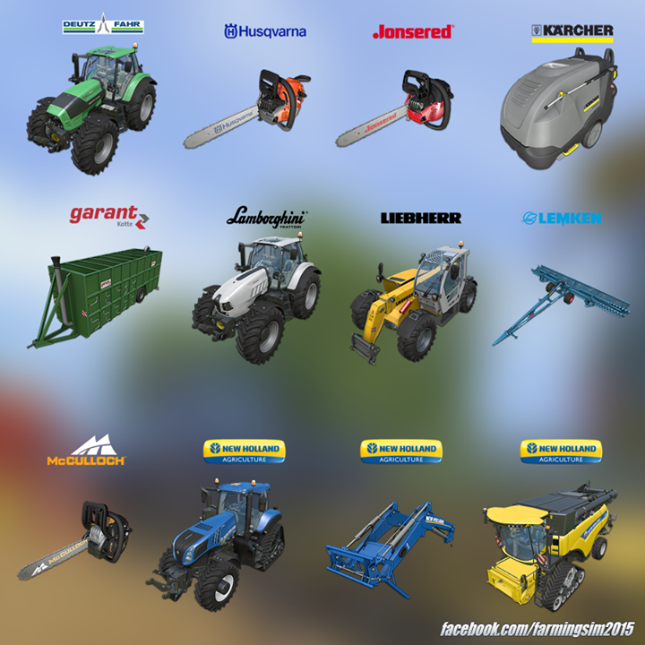
List of Govt Schemes available
NABARD Unit Cost
Bank Schemes
Select stage of the Crop
Land Preparation
Farm Mechanization
Yes
No
Do you own Equipment
Yes
No
Do you want to buy
Yes
No
Do you want to Rent
Yes
No
List of available Renters

Slide 9
Innovation
Team
Titans
Combine Interactive simulation game with advisory services
Using real topographical, Agro Ecological and Market Data.
Single Platform for linking different system models (eg crop models, hydrological models ,value chain).
It allows to experiment with adaptation strategies.

Slide 10






Impact
Farmers gain conceptual knowledge by simulation is less risky
Get low cost advice on the specific queries.
Better planning of Farm activities
Diffusion and Increasing adoption rate of agriculture Technologies
Adaptation strategies to Climate Change
Strengthening Natural resource management
Increased Value addition
Sustainable agriculture
Motivating Next Generation to take farming as Business
Sustainable Agriculture
Food Security
Combat climate change Impact
Reduce Poverty
Sustainable use of eco systems
Inclusive Agriculture Education

Slide 11
Revenue Model
Team
Titans
From Farmer Producer Organizations, Primary Agriculture Coops, Agri Business Schools, Corporates Houses in Agriculture, , Fertilizer, Seed and Pesticide Companies, Rural Banks in the form of extensive services, Advertisements revenue, Agri extension Networks – Govt. Departments, Cooperatives, Foundations, Support from CSR funded projects, Agricultural Marketing Boards.
2000+
1 Lakh
50000
25
200+
FPO’s
PACS
Rural Banks
Mktg Boards
Corporates

Slide 12




Proposed Technology Stack

Slide 13
your
Questions
Answers

